Slide 1
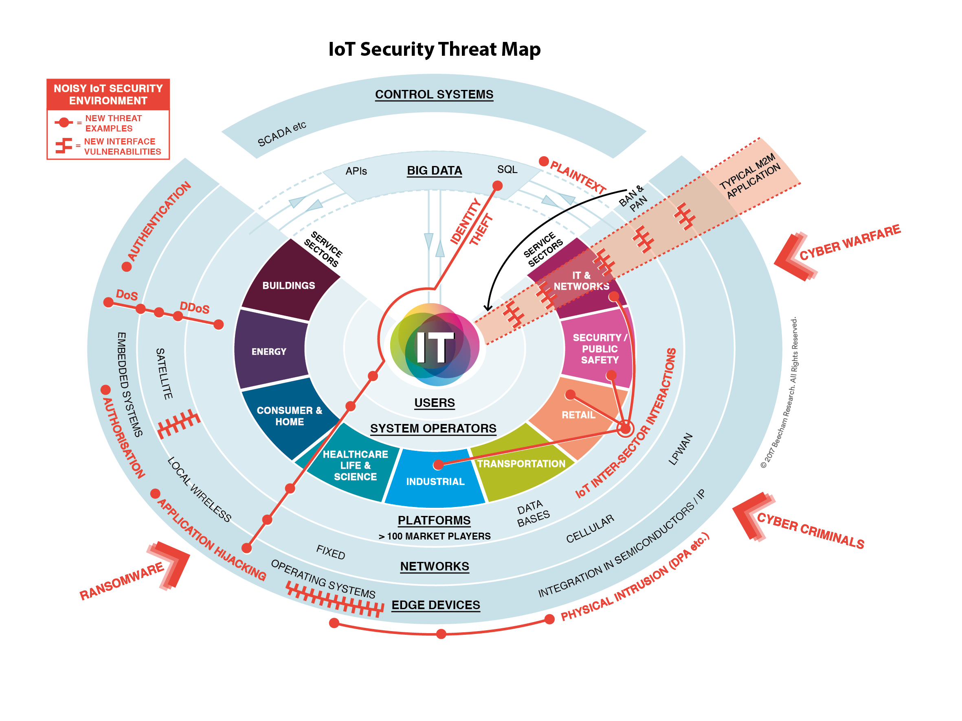
IoT Security Threat Map

